Slide 1




Slide 2




Slide 3
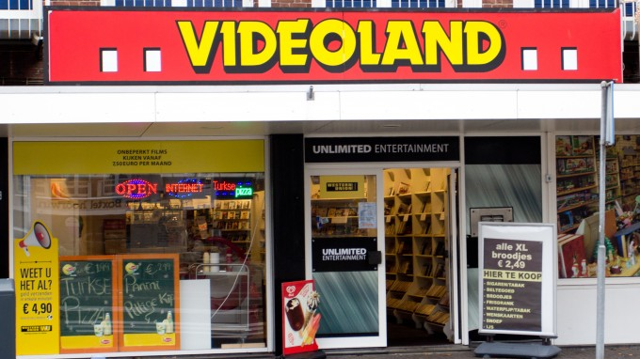

Slide 4
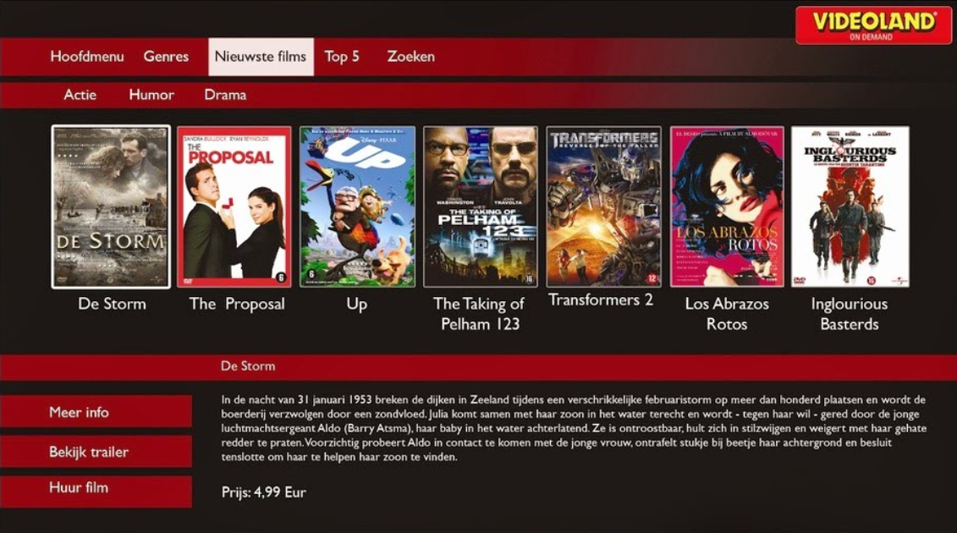
Notes:
-> Netflix had started in US, UK, Scandinavia
-> we wanted to launch SVOD in NL before NFX
…and jumped into this adventure…

Slide 5

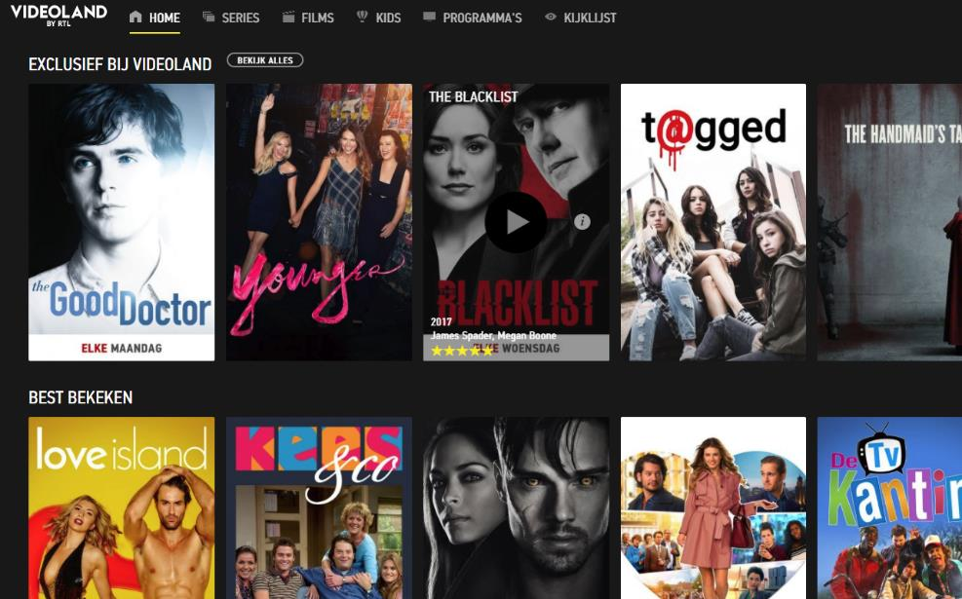
Offer a unique streaming experience
€8.99 per month
No advertising
750 Dutch titles
More than 1,000 international titles

Slide 6


Customer Care

Slide 7





Slide 8

Best service
Easy, fast, simple
Dagelijks bereikbaar
10:00 - 22:00
Online focus

Slide 9

KPI’s
% Contacten
NPS
Contact SLA’s

Slide 10
KPI’s
% Contacten
NPS
Contact SLA’s

Slide 11
KPI’s
Social
95% < 1 uur
Chat
% Contacten
95% < 1 minuut
NPS
Telefoon
60% < 30 sec
Contact SLA’s
Email
95% < 48 uur

Slide 12

Voordelen
Efficiënt
Transparant
Klanten helpen elkaar

Slide 13

Aanbod
NPS +45
NPS +39
NPS +10
NPS +21

Slide 14


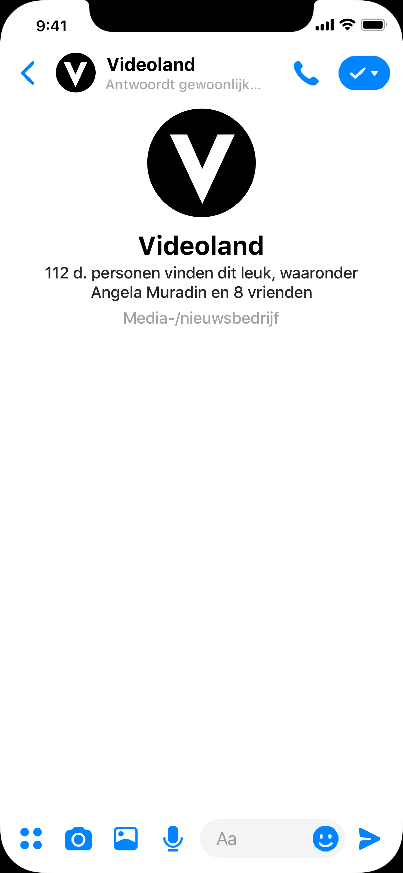

Chatbot

Slide 15
Chatbot

Slide 16

Chatbot

Slide 17

Chatbot

Slide 18
Chatbot

Slide 19
Chatbot

Slide 20
Chatbot

Slide 21
Chatbot

Slide 22
Chatbot

Slide 23
Vragen?

