Slide 2
Data Science beyond the hype
Something to discuss in 15 minutes
April 2nd 2018
Arjan van den Born

Slide 3
We tend to overestimate the effect of a technology in the short run and underestimate the effect in the long run.
Amara’s Law

Slide 4
CONTENT
The disruptive force called data science
JADS – Bridging Business and Technology
Cool examples
The Impact on Business
The Dark Side of Data

Slide 5
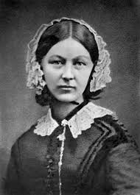
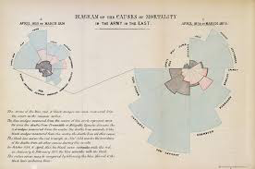
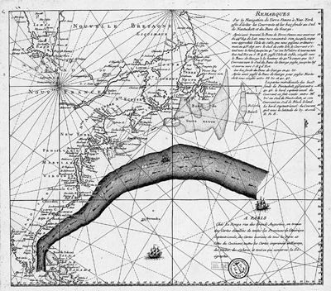
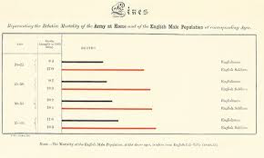
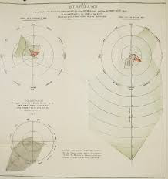
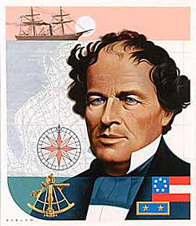
The Datafication era started in the early 1800’s
Florence Nightingale , London 1820-1910
Mathew Fontaine Maury, Virginia 1806-1873

Slide 6
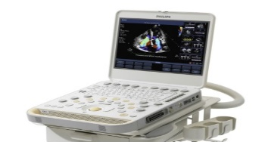
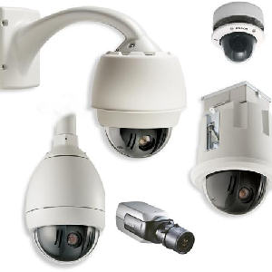
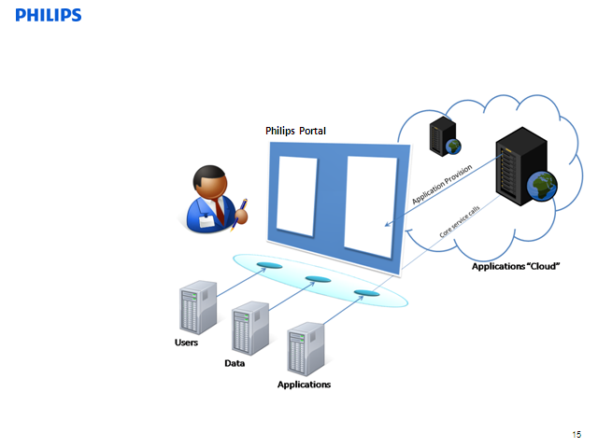
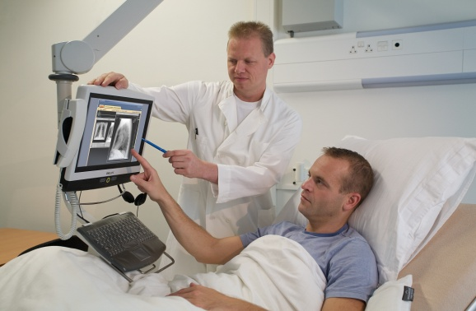
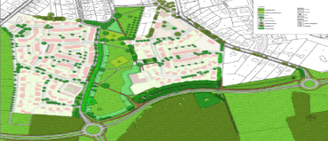
The Always-On Society generates true Big Data
Connected devices
Sensing and monitoring data
Providing
connected Apps
Philips Value Platform
Extracting
meaningful information
Enhancing the user experience
Connected Solutions
6

Slide 7
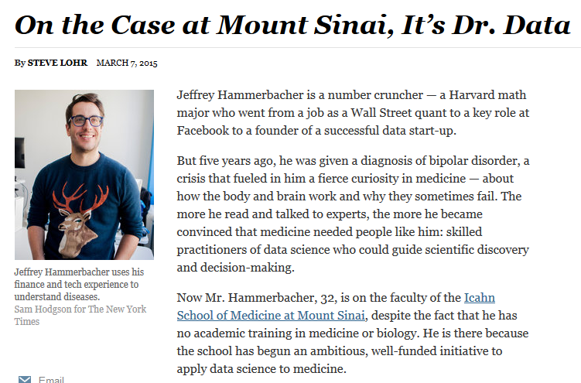
Every profession becomes a Data Science Profession
Health Analytics
Marketing Analytics
HR Analytics
Accounting & Finance Analytics
7

Slide 8
JADS: What, Why & How

Slide 9
WHY JADS? Bringing Technology and Sociology/Business together

Slide 10
At JADS We Build 3 Bridges

Slide 11
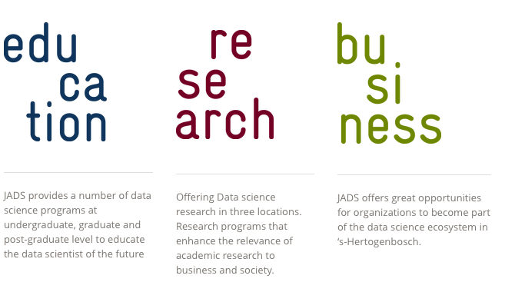
JADS: close collaboration of 2 universities on 3 areas within data science

Slide 12
Education: 10 data science programs offered at 3 locations
Graduate School Den Bosch
2000 Students
Joint Bachelor Data Science

Slide 13
Expected growth

Slide 14
Five unique elements of our proposition
Size: 2000 students in various programs with 3 research centers
Novelty: educational programs are newly designed using DS design criteria
Multi-disciplinary: Mixing business and IT to drive innovation
Ambition & Quality: world class staff & students to make an impact
Relevance: Intense collaboration with industry in education and research

Slide 16
Cool Examples

Slide 17
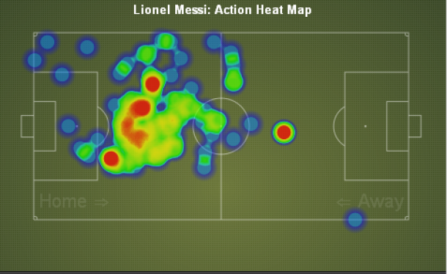
HEAT MAPS

Slide 18
Humanitarian Food

Slide 20
Detecting Confusion of the Elderly

Slide 21
MUSIC AS A MEDICINE

Slide 22
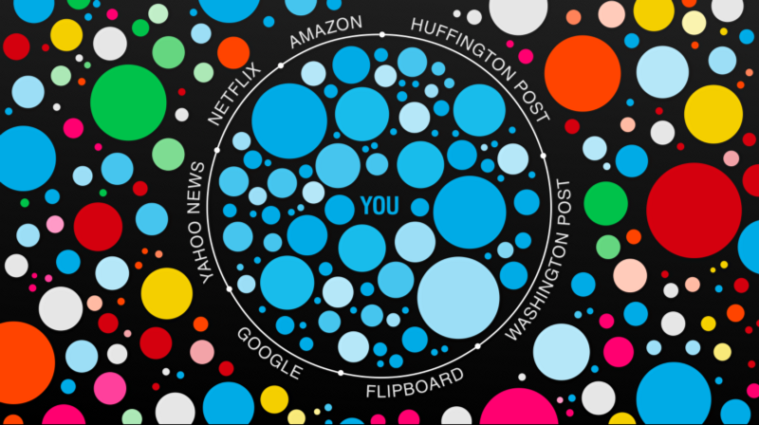
Alternative Recommender Systems

Slide 23
The impact of data science on business

Slide 24
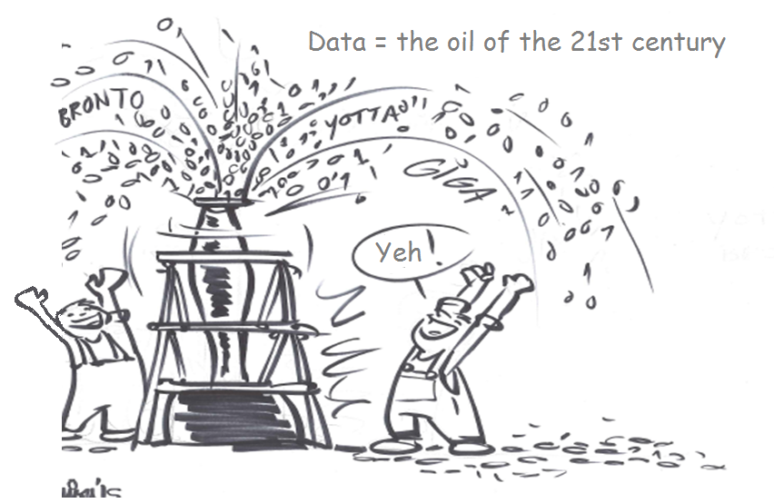
The vision is clear: data is the new oil water

Slide 25
Research shows significant productivity gains
When investing at the same time in man & machine

Slide 27
OF DATA

Slide 28
NO SCIENCE
NO WISDOM

Slide 29
The Emergence of Natural Monopolies

Slide 30
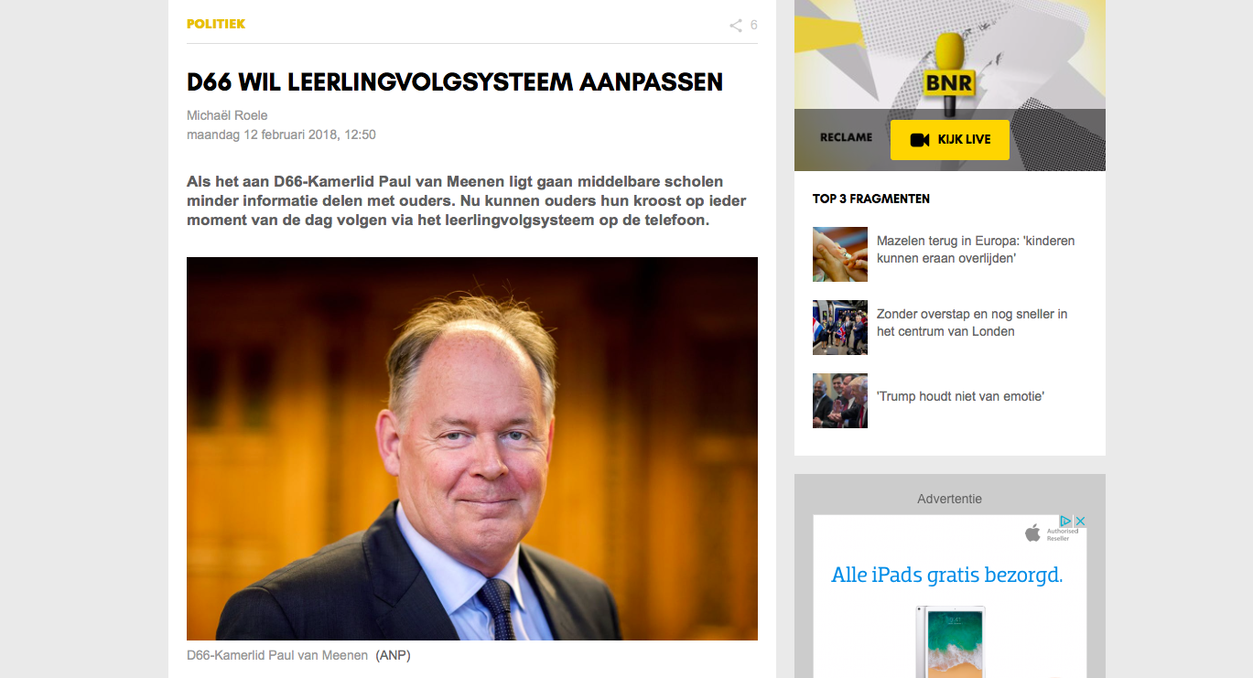
Is it Too Much Information?

Slide 31
Alternative Facts

Slide 32
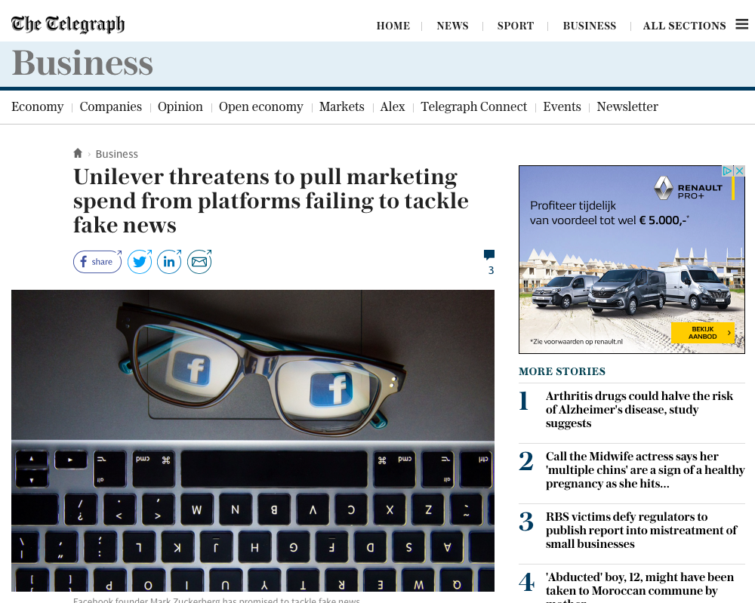
The move away from fake news

Slide 33
RISE OF THE AI APOCALYSE

Slide 35
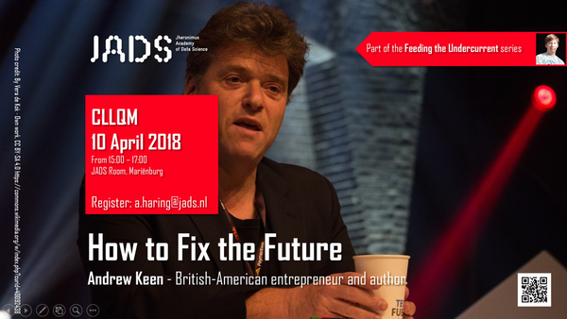
FIX THE FUTURE: RESPONSIBLE DATA SCIENCE

Slide 36
Finally

Slide 37
Meet Young Scientists: Thursday 14 June 2018

Slide 39
